Slide 1
JAVA CODING QUESTIONS WITH EXPLANATIONS

Slide 2
ARRAYS
1. Largest number in an Array
2. Write code to print only the even numbers from an array. 3. Duplicate Elements in an Array: Finding and Printing Duplicates
4. Write a program to find the second highest integer in an array
5. Write Java code to print all the array elements that appear at least 2 times.
6. Write Java code to remove duplicate elements from an array without using HashMap
7. Initialize the array and find the missing letters (10, 9, 2, 1) and print:
8. Move all zeros in an array to the end
9. Move all odd numbers to the front and even numbers to the end in an array.
10. Reverse an array in subsets of size N.
11. Count Odd & Even Numbers in an Array
12. Remove Duplicates in an Array using Hashset
13. Remove Duplicates from ArrayList
14. Search an Element in an Array 15. Sort an Array

Slide 3
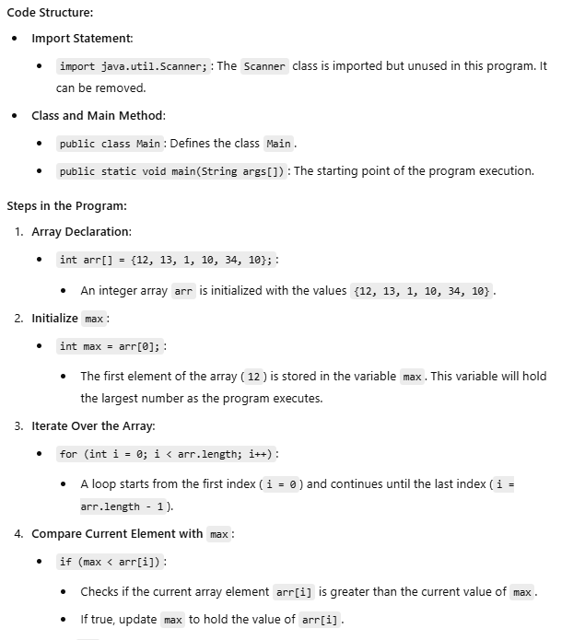
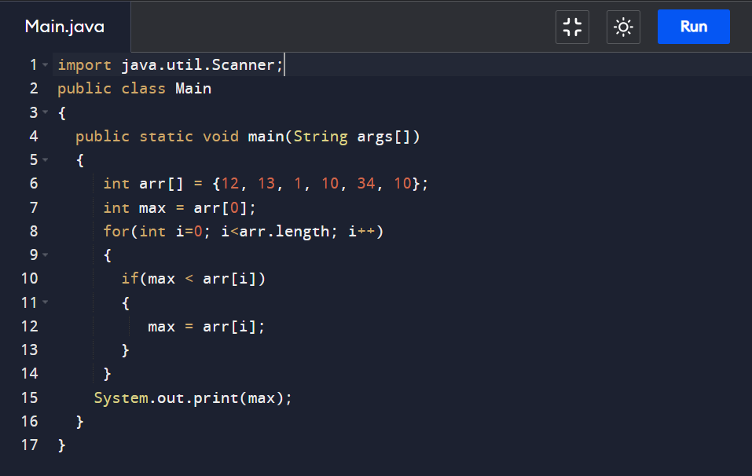
1. .Largest number in an Array

Slide 4
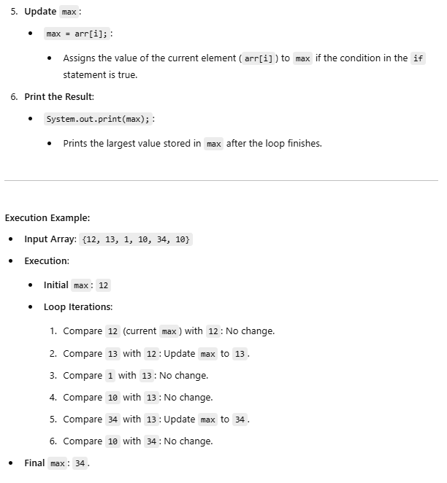
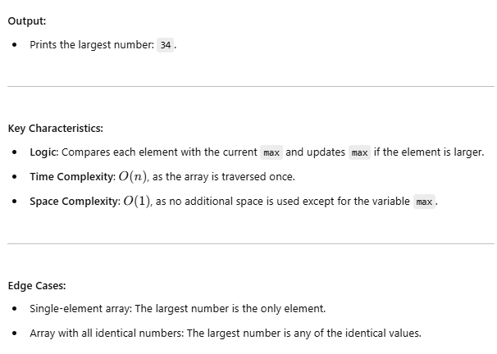

Slide 5
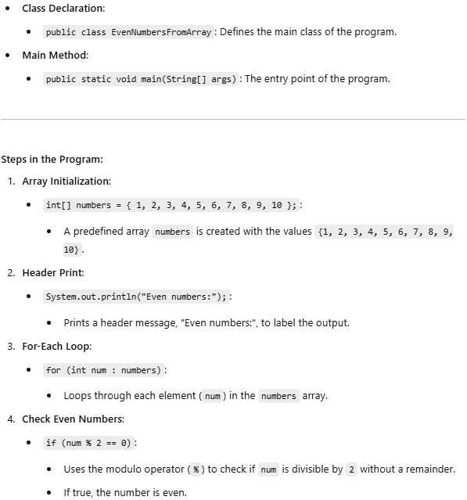
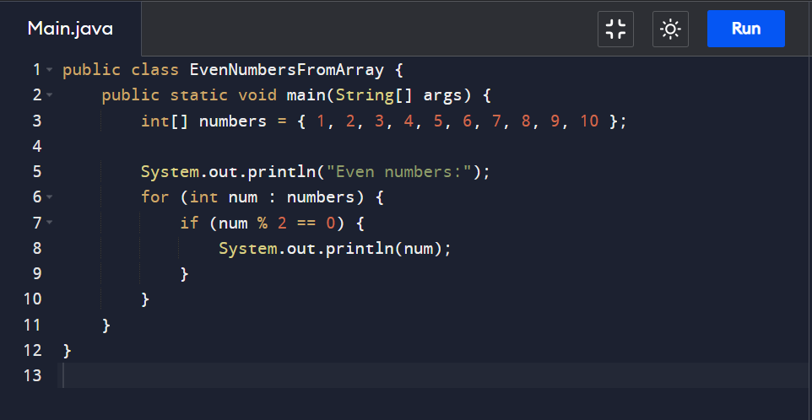
2. Write code to print only the even numbers from an array.

Slide 6
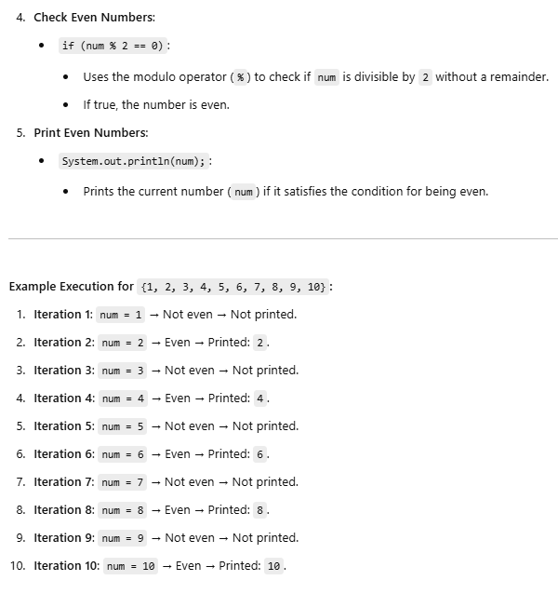
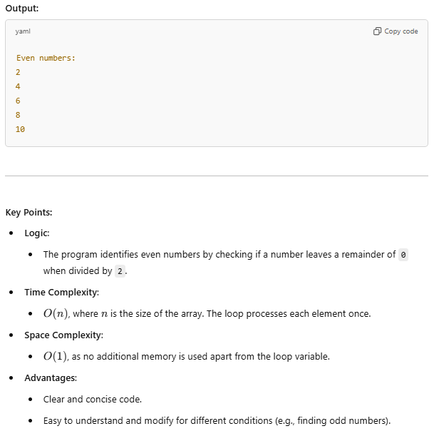

Slide 7
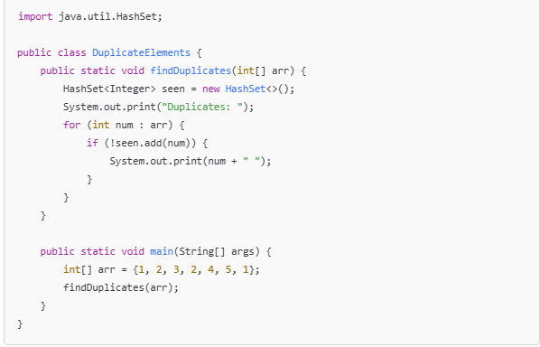
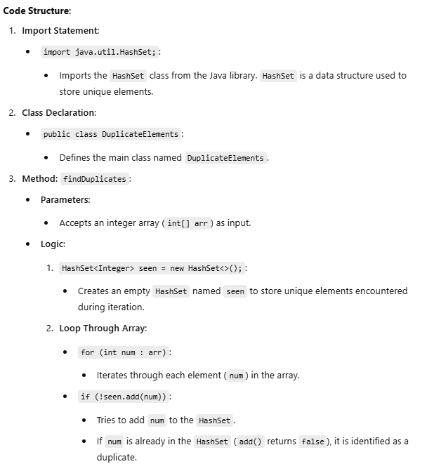
3. Duplicate Elements in an Array: Finding and Printing Duplicates

Slide 8
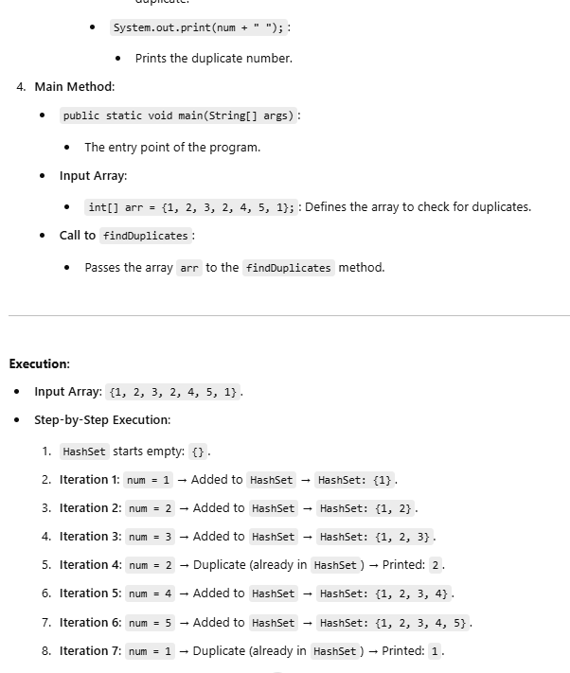
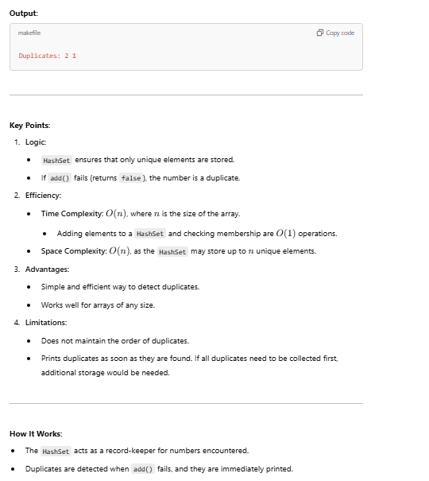

Slide 9
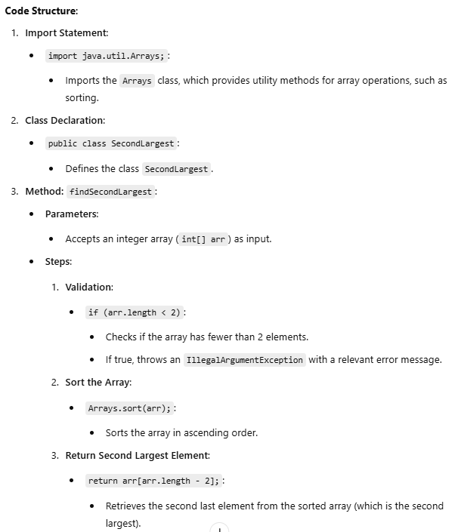
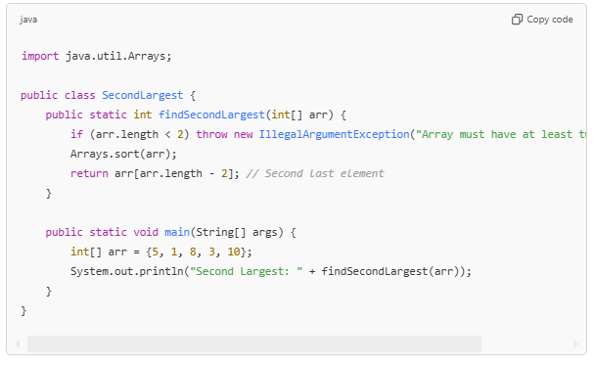
4. . Write a program to find the second highest integer in an array

Slide 10
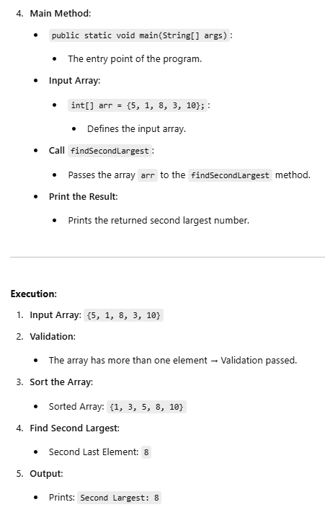
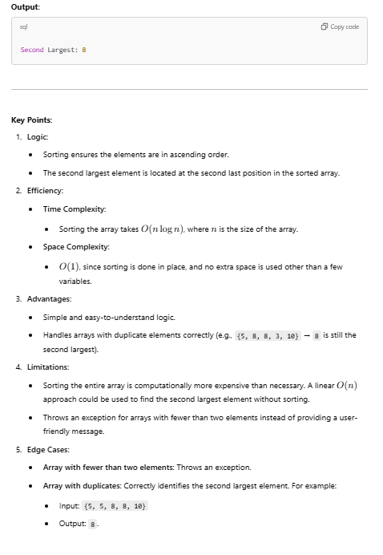

Slide 11
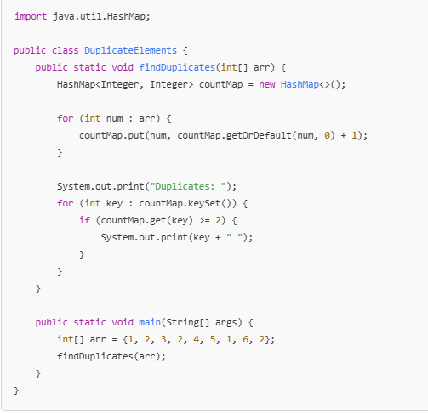
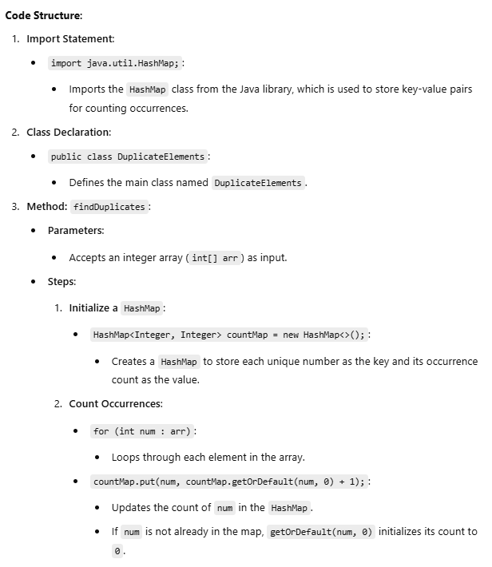
5. Write Java code to print all the array elements that appear at least 2 times.

Slide 12
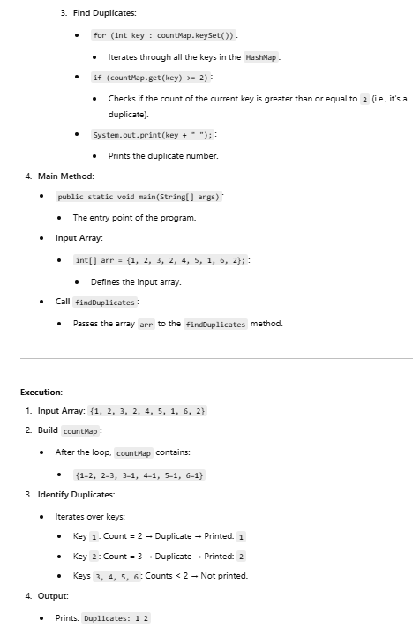
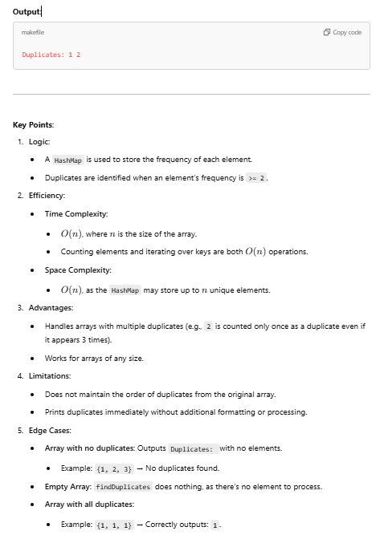

Slide 13
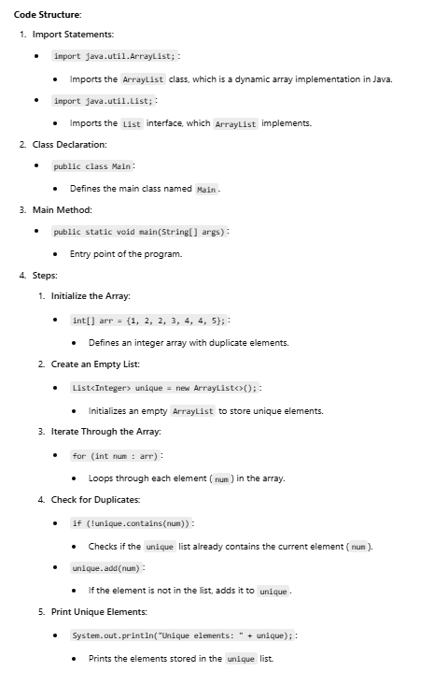
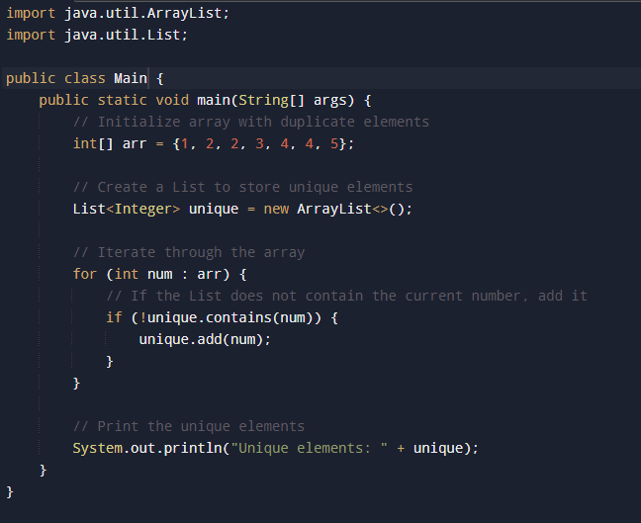
6. Write Java code to remove duplicate elements from an array without using HashMap

Slide 14
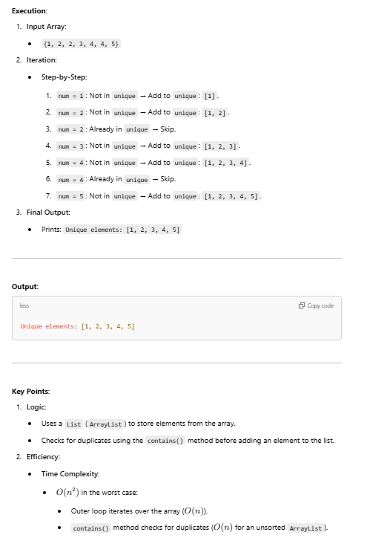
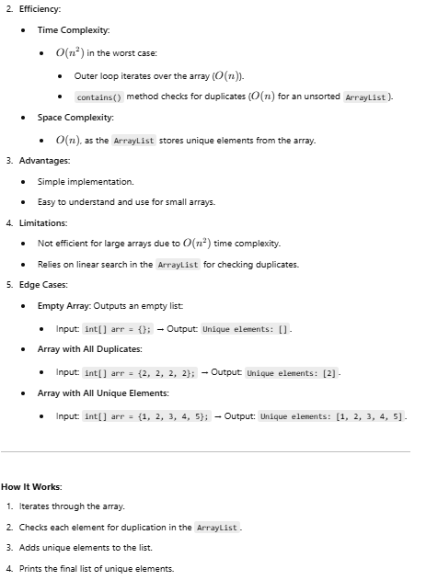

Slide 15
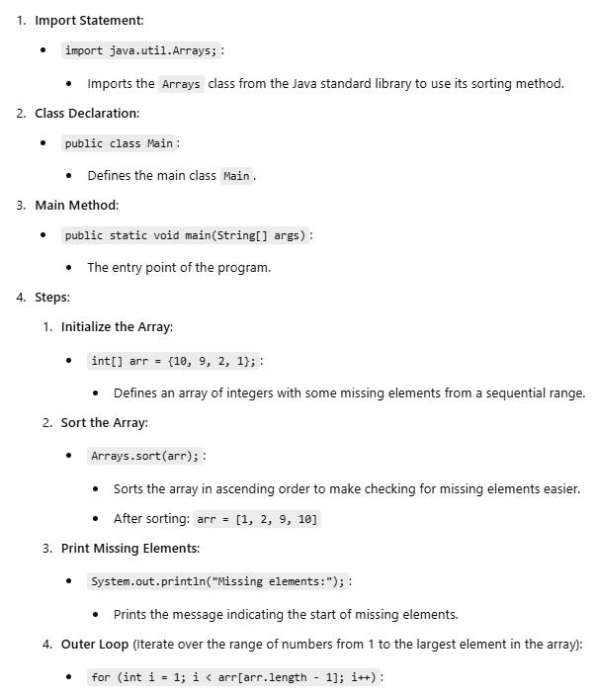
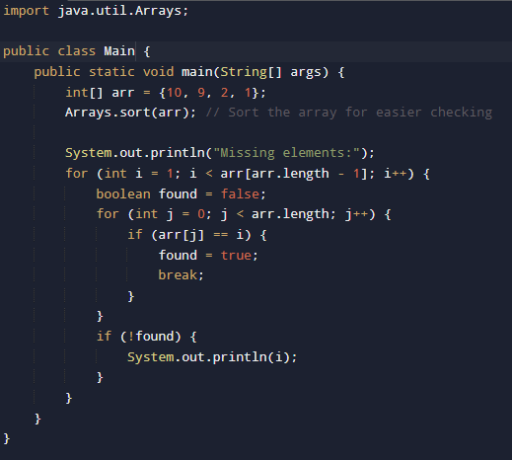
7. Initialize the array and find the missing letters (10, 9, 2, 1) and print:

Slide 16
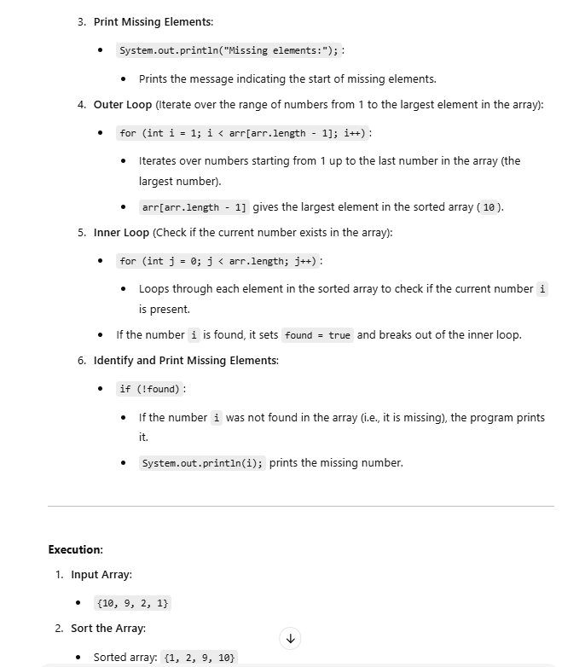
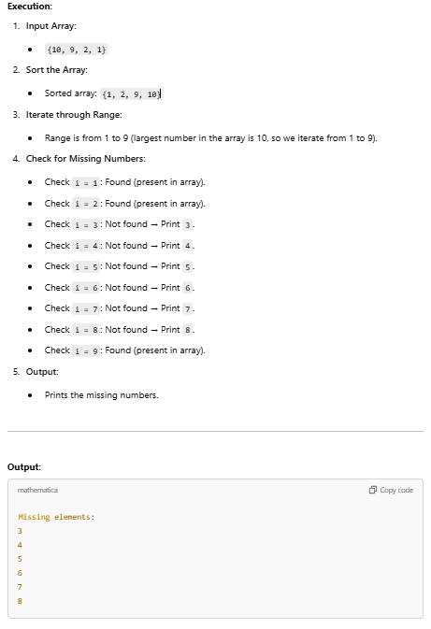

Slide 17
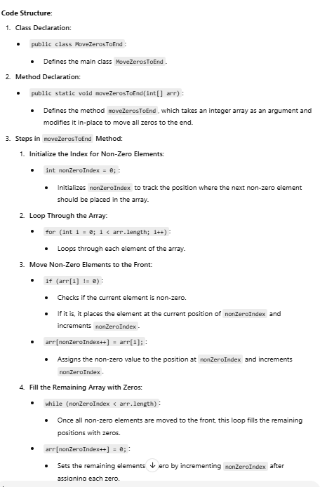
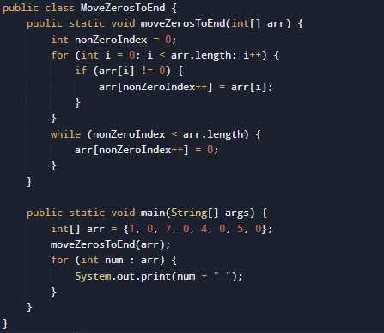
8. Move all zeros in an array to the end

Slide 18
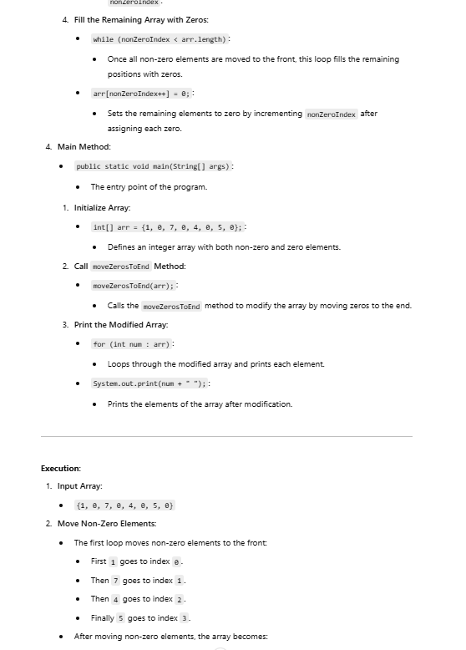
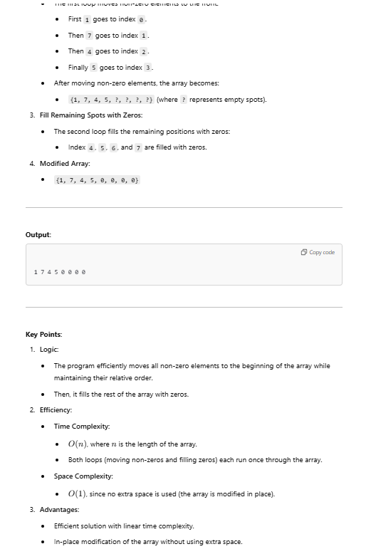

Slide 19
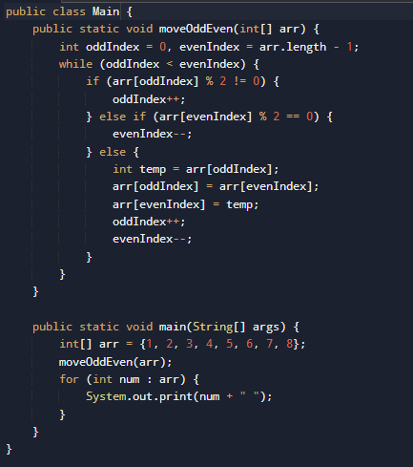
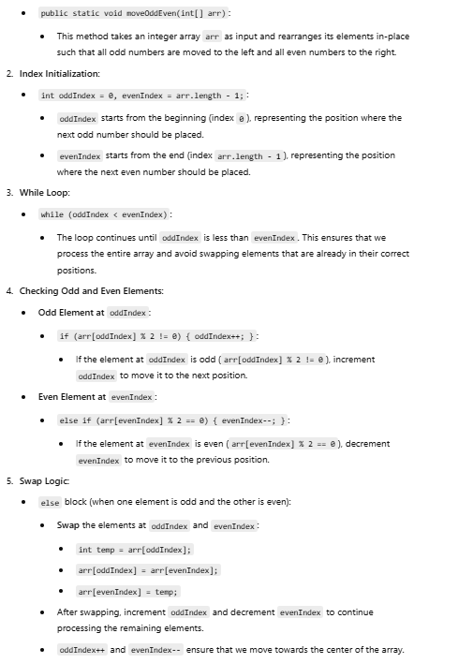
9. Move all odd numbers to the front and even numbers to the end in an array.

Slide 20
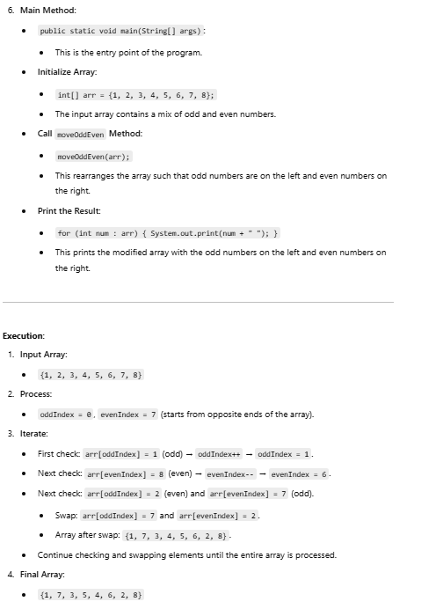
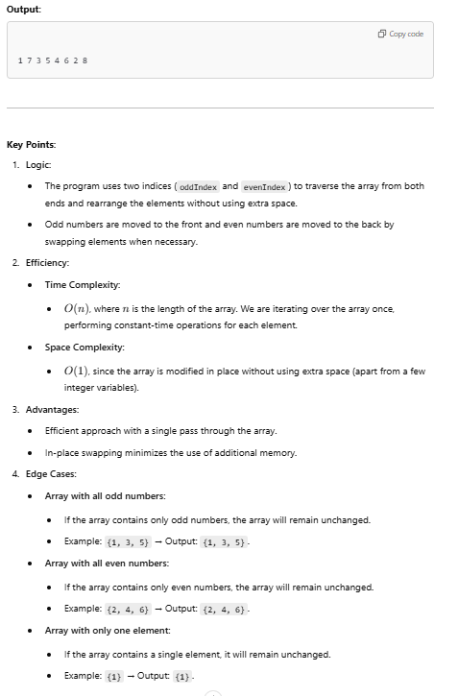

Slide 21
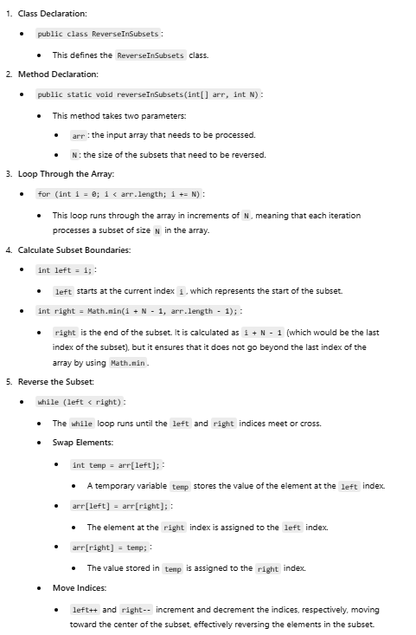
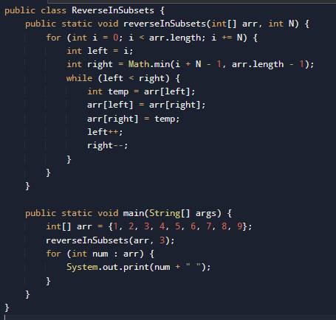
10. Reverse an array in subsets of size N.

Slide 22
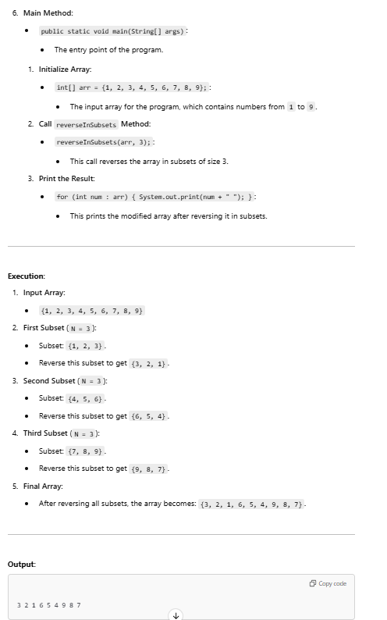
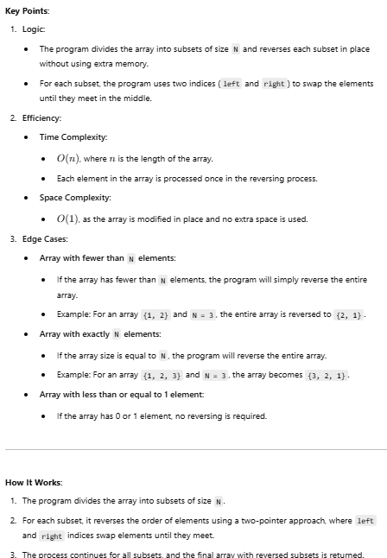

Slide 23
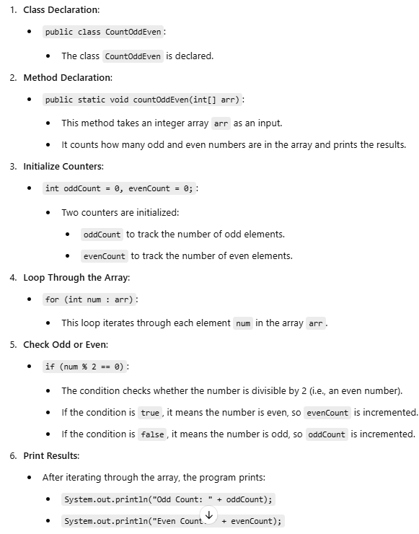
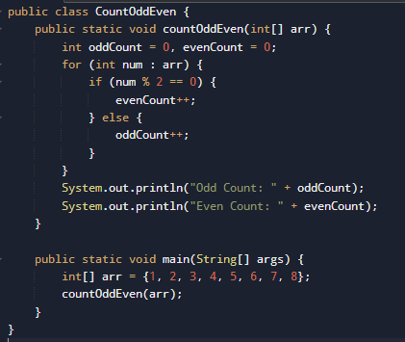
11. Count Odd & Even Numbers in an Array

Slide 24
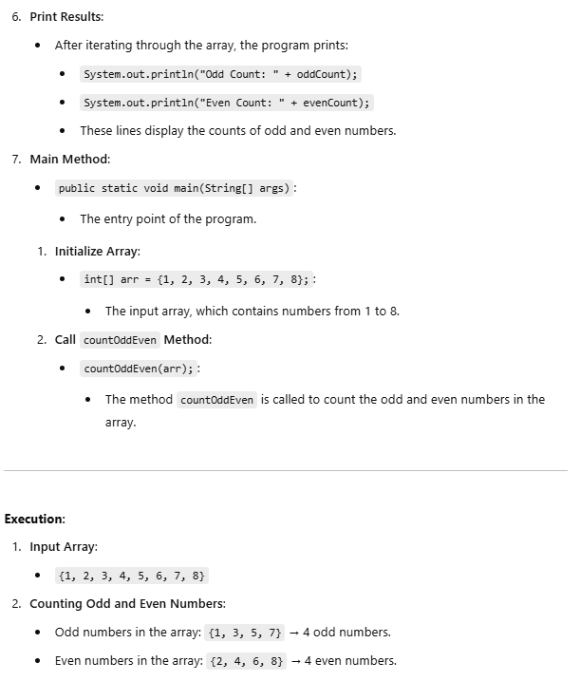
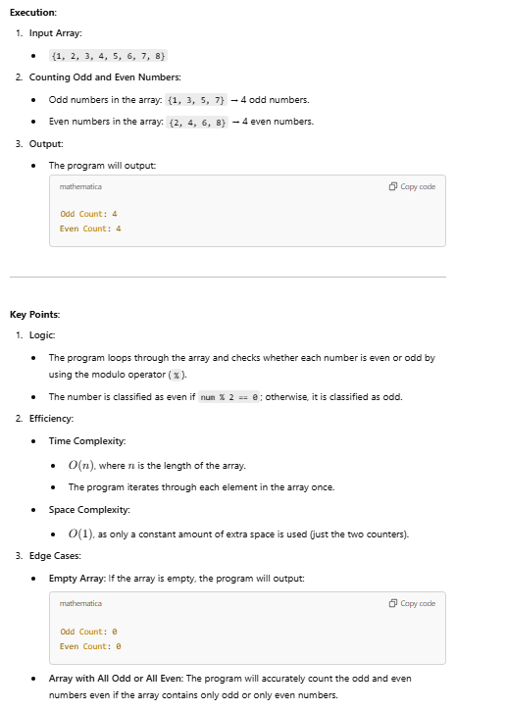

Slide 25
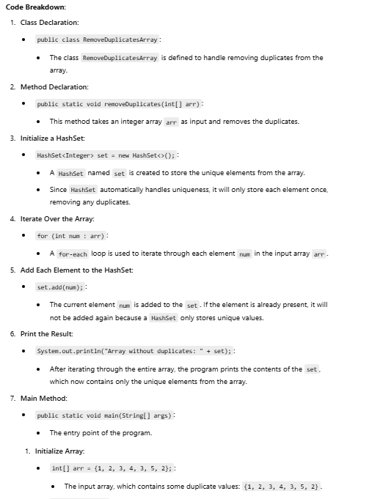
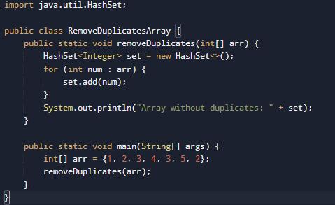
12. Remove Duplicates in an Arrayusing Hashset

Slide 26
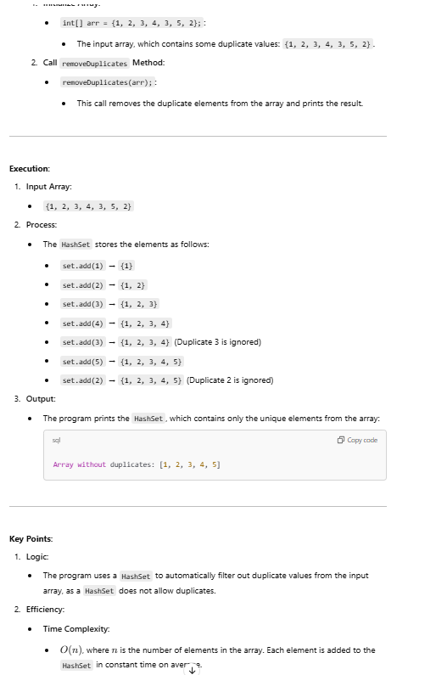
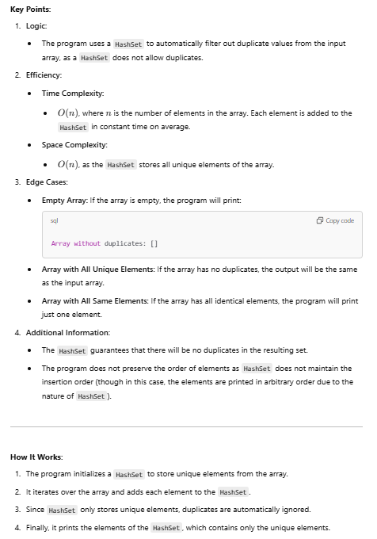

Slide 27
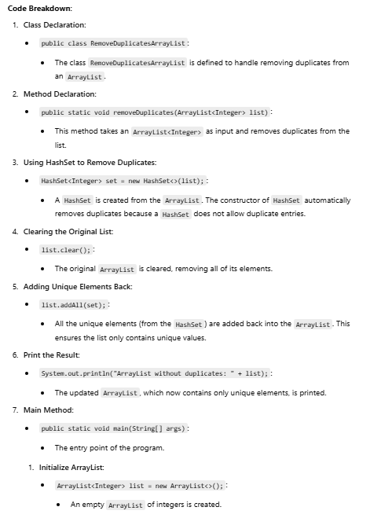
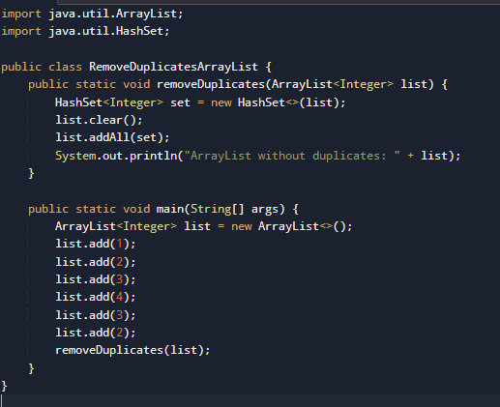
13. Remove Duplicates from ArrayList

Slide 28



Slide 29


14. Search an Element in an Array

Slide 30



Slide 31


15. Sort an Array

Slide 32



